Slide 1
Creating a new document

Slide 2
Creating a new document
You're already familiar with the basic method of creating a new document using the insert() method, as you previously did in earlier examples.
Besides the insert() method, there are two more methods called update() and save() to create new objects.

Slide 3
Creating a document using insert()
The most common way to create a new document is to use the insert() method.
The insert() method takes a single argument that represents the new document.
To insert a new post, just issue the following command in the MongoDB shell:
> db.posts.insert({"title":"Second Post", "user": "alice"})

Slide 4
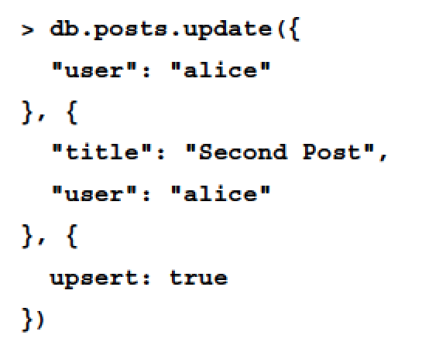
Creating a document using update()
The update() method is usually used to update an existing document.
You can also use the upsert flag to create a new document, if no document matches the query criteria:
In the preceding example, MongoDB will look for a post created by alice and try to update it.
Considering the fact that the posts collection doesn't have a post created by alice and the fact you have used the upsert flag, MongoDB will not find an appropriate document to update and will create a new document instead.

Slide 5
Creating a document using save()
Another way of creating a new document is by calling the save() method, passing it a document that either doesn't have an _id field or has an _id field that doesn't exist in the collection:
> db.posts.save({"title":"Second Post", "user": "alice"})
This will have the same effect as the update() method and will create a new document instead of updating an existing one.

Slide 6
Reading documents

Slide 7
Reading documents
The find() method is used to retrieve a list of documents from a MongoDB collection.
Using the find() method, you can either request all the documents in a collection or use a query to retrieve specific documents.

Slide 8
Finding all the collection documents
To retrieve all the documents in the posts collection, you should either pass an empty query to the find() method or not pass any arguments at all.
The following query will retrieve all the documents in the posts collection:
> db.posts.find()
Furthermore, performing the same operation can also be done using the following query:
> db.posts.find({})
These two queries are basically the same and will return all the documents in the posts collection.

Slide 9
Using an equality statement
To retrieve a specific document, you can use an equality condition query that will grab all the documents which comply with that condition.
For instance, to retrieve all the posts created by alice, you will need to issue the following command in the shell:
> db.posts.find({ "user": "alice" })
This will retrieve all the documents that have the user property equal to alice.

Slide 10
Using query operators
Using an equality statement may not be enough.
To build more complex queries, MongoDB supports a variety of query operators.
Using query operators, you can look for different sorts of conditions.
For example, to retrieve all the posts that were created by either alice or bob, you can use the following $in operator:
> db.posts.find({ "user": { $in: ["alice", "bob"] } })

Slide 11
Building AND/OR queries
When you build a query, you may need to use more than one condition.
Like in SQL, you can use AND/OR operators to build multiple condition query statements.
To perform an AND query, you simply add the properties you'd like to check to the query object.
For instance, take a look at the following query:
> db.posts.find({ "user": "alice", "commentsCount": { $gt: 10 } })
It is similar to the find() query you've previously used, but adds another condition that verifies the document's commentCount property and will only grab documents that were created by alice and have more than 10 comments.

Slide 12
Building AND/OR queries (continued)
An OR query is a bit more complex because it involves the $or operator.
To understand it better, take a look at another version of the previous example:
> db.posts.find( { $or: [{ "user": "alice" }, { "user": "bob" }] })
Like the query operators example, this query will also grab all the posts created by either bob or alice.

Slide 13
Updating existing documents

Slide 14
Updating existing documents
Using MongoDB, you have the option of updating documents using either the update() or save() methods.

Slide 15
Updating documents using update()
The update() method takes three arguments to update existing documents.
The first argument is the selection criteria that indicate which documents to update
the second argument is the update statement
the last argument is the options object.

Slide 16
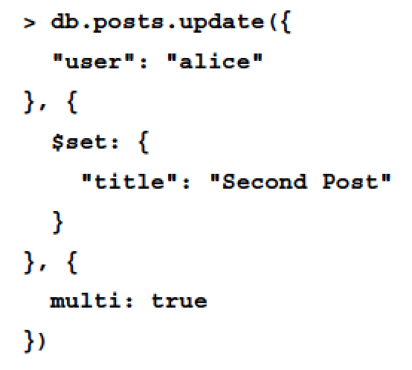
Updating documents using update() (continued)
For instance, in the following example, the first argument is telling MongoDB to look for all the documents created by alice, the second argument tells it to update the title field, and the third argument is forcing it to execute the update operation on all the documents it finds:

Slide 17
Updating documents using update() (continued)
Notice how the multi property has been added to the options object.
The update() method's default behavior is to update a single document, so by setting the multi property, you tell the update() method to update all the documents that comply with the selection criteria.

Slide 18
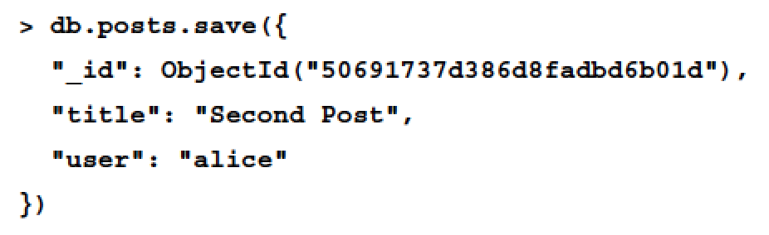
Updating documents using save()
Another way of updating an existing document is by calling the save() method, passing it a document that contains an _id field.
For instance, the following command will update an existing document with an _id field that is equal to ObjectId("50691737d386d8fadbd6b01d"):
It's important to remember that if the save() method is unable to find an appropriate object, it will create a new one instead.

Slide 19
Deleting documents

Slide 20
Deleting documents
To remove documents, you will need to use the remove() method.
The remove() method can accept up to two arguments.
The first argument is the deletion criteria
The second argument is a Boolean argument that indicates whether or not to remove multiple documents.

Slide 21
Deleting all documents
To remove all the documents from a collection, you will need to call the remove() method with no deletion criteria at all.
For example, to remove all the posts documents, you'll need to execute the following command:
> db.posts.remove({})
Notice that the remove() method is different from the drop() method, as it will not delete the collection or its indexes.
To rebuild your collection with different indexes, it is preferred that you use the drop() method.

Slide 22
Deleting multiple documents
To remove multiple documents that match a criteria from a collection, you will need to call the remove() method with a deletion criteria.
For example, to remove all the posts made by alice, you'll need to execute the following command:
> db.posts.remove({ "user": "alice" })
Note that this will remove all the documents created by alice, so be careful when using the remove() method.

Slide 23
Deleting a single document
To remove a single document that matches a criteria from a collection, you will need to call the remove() method with a deletion criteria and a Boolean stating that you only want to delete a single document.
For example, to remove the first post made by alice, you'll need to execute the following command:
> db.posts.remove({ "user": "alice" }, true)
This will remove the first document that was created by alice and leave other documents even if they match the deletion criteria.

